Slide 1
Non-Conformities:
The Weakest Link
TDI-Brooks International
Sep 2014

Slide 2
Definition
Non-conformity- a failure to comply with a standard, written requirement or the TDI-Brooks Safety Management Manual (SMM).
(Saying we do something but not actually doing it)

Slide 3
How We Find Them
Most Non-Conformities (NCs) are found through internal audits and external audits.
They can also be discovered through an incident, Master’s Reviews of the SMM or a Suspected Non-Conformity Report.

Slide 4
How We Resolve Them
SMM Chapter 9 describes how we correct non-conformities.
This is described in the Non-Conformities Processing Chart.

Slide 5
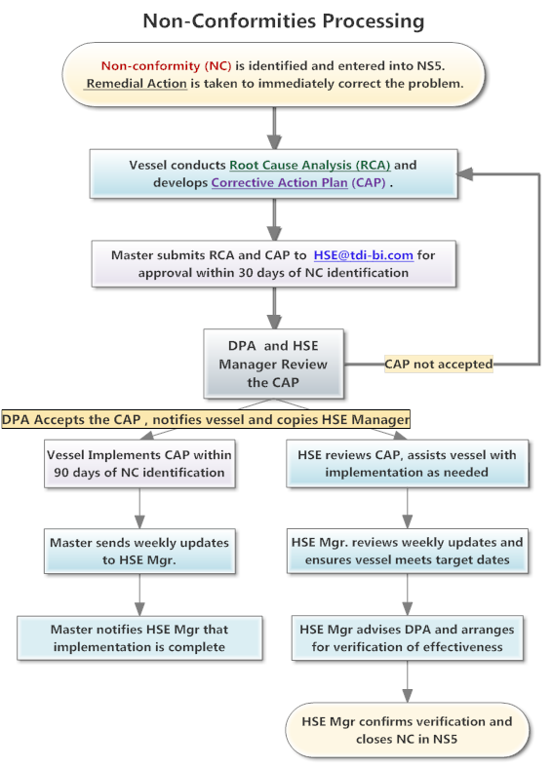
Chart Overview

Slide 6
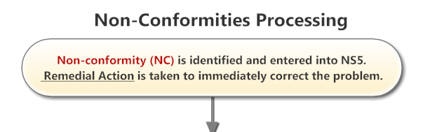
The Process
The NC is identified, reported to the HSE Manager and DPA and entered into NS5.

Slide 7
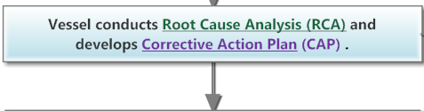
Who is Responsible?
The VESSEL is responsible for investigating the root cause and proposing a corrective action.

Slide 8
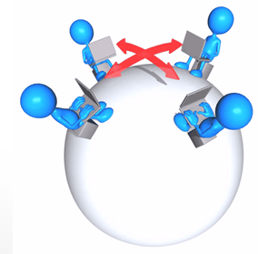
How Do We Do That?
Start by gathering a team of trained investigators and people who have expertise related to the NC.
Master
Mate
Engineer
Deckmen
Oilers
ABs
OSs

Slide 9
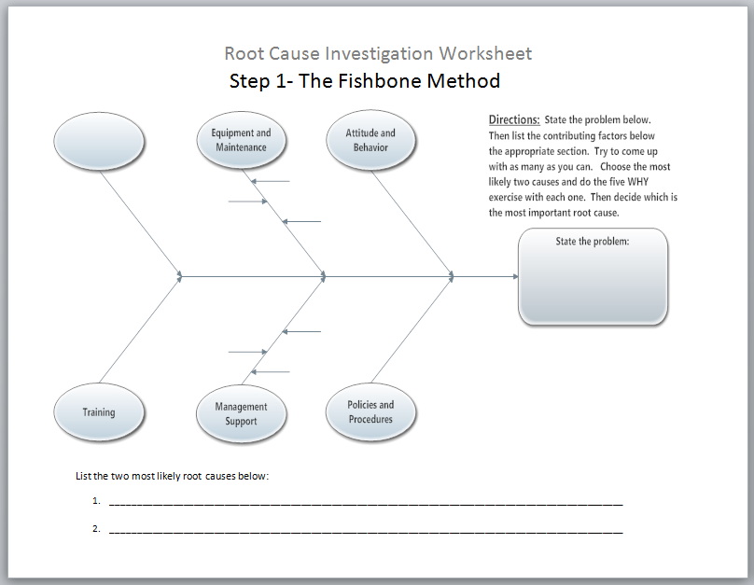
Where Do We Start?
TDI-Brooks has developed worksheets to assist the vessel in conducting the Root Cause Analysis.

Slide 10
What Method Do We Use?
The worksheets guide the vessel through the cause/ effect diagram to list all possible causes, then uses the 5 WHYs on the most likely causes.
The worksheets are tools to help you do the real work- FIND THE ROOT CAUSE (RC).
The goal is to SOLVE THE PROBLEM – not fill out the papers!

Slide 11
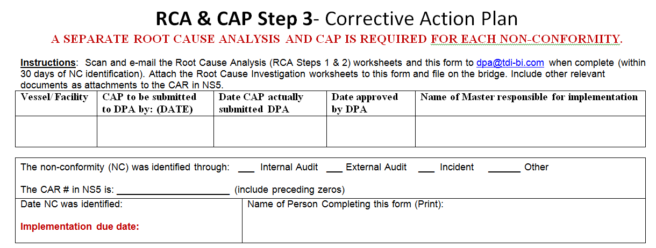
Found RC- Now What?
Now you have found source of the problem, you must create a solution- called the Corrective Action Plan or CAP. There is a worksheet for that.

Slide 12
Remedial or Corrective?
Remedial Action is what was done as soon as the NC was discovered to contain the immediate problem
Corrective Action finds and fixes the root of the problem.

Slide 13
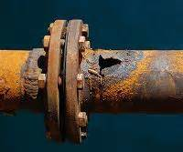
Remedial or Corrective?
Example:
Leaks in a pipe due to rust/ corrosion.

Slide 14
Remedial Action
Patching the hole may get you to port, but will not SOLVE THE PROBLEM.
The patch will not prevent the pipe from leaking again due to the same problem.

Slide 15
Corrective Action
The goal of Corrective Action is the prevent the NC from happening again.
You must state in the CAP how you will prevent the NC from recurring.
This is referred to as the Preventative Action.

Slide 16
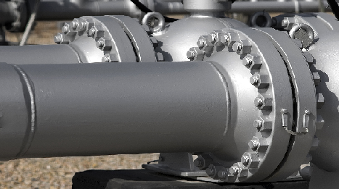
Corrective Action
Corrective Action corrects the problem at the source - the corroded pipe.
Replacing the pipe prevents it from leaking again due to the same root cause – corrosion.

Slide 17
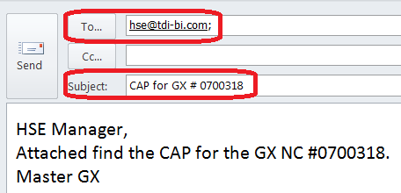
CAP- submit in 30 days
The Master is responsible for submitting the complete RCA & CAP package to HSE@tdi-bi.com within 30 days of the date the NC was identified (audit or incident date).

Slide 18
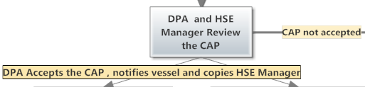
DPA & HSE Review CAP
If the CAP is approved, the vessel implements it.
If the CAP is not approved, the vessel starts over with the RCA.

Slide 19
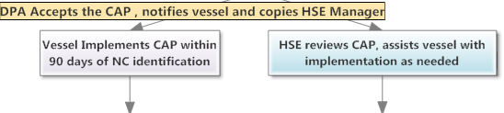
Implementation
Put your plan into action!
Contact HSE Manager with any questions.

Slide 20

Weekly Reports
Some CAPs take time to implement.
The Master will send weekly updates to the HSE Manager to explain progress.
HSE Manager reviews updates and documents the CAR in NS5.

Slide 21

Completion
Master notifies HSE Mgr when all action steps in CAP are completed.
HSE Manager arranges for verification of effectiveness.

Slide 22
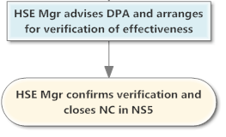
Verification
An office representative must verify that the CAP has been effective in resolving the problem.

